Slide 1

PROJECT PROPOSAL PRESENTATION
Prepared By: Manjushree Tamang, Prinsha shrestha, Priya Shrestha, Ridhi Maskey

Slide 2
TITLE FOR THE PROPOSAL
FLOWER SPECIES CLASSIFICATION USING DEEP LEARNING TECHNIQUES

Slide 3

Research Questions
Can a deep learning-based image classification model accurately identify different species of flowers based on their visual characteristics?

Slide 4



Dataset Description
Dataset:
Flower Classification
This is the dataset for flower classification that was obtained from the recommended datasets provided in the shared drive folder.
The dataset contains 4,340 images spread across 5 classes:
·Daisy
·Tulip
·Dandelion
·Rose
·Sunflower
Source:
This dataset was chosen from the recommended datasets drive folder.
Link:
https://drive.google.com/drive/folders/1Rn8Ccm8OvmtsUrW2r5WFmzespEDEcFD
Image Distribution: Each class has around 800 images.

Slide 5
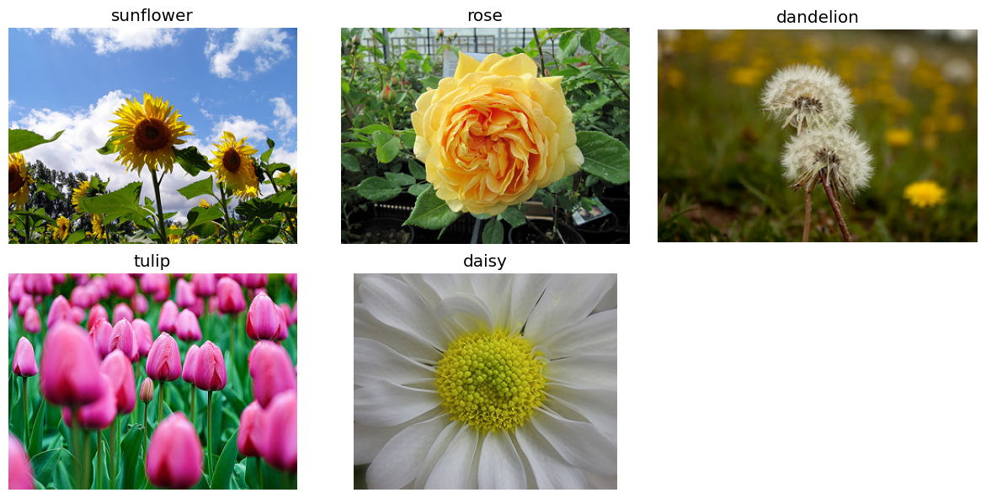
Data Visualization
Sample images of flower from each class

Slide 6
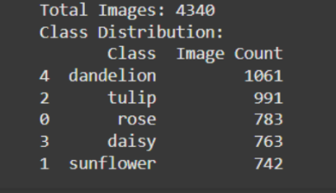
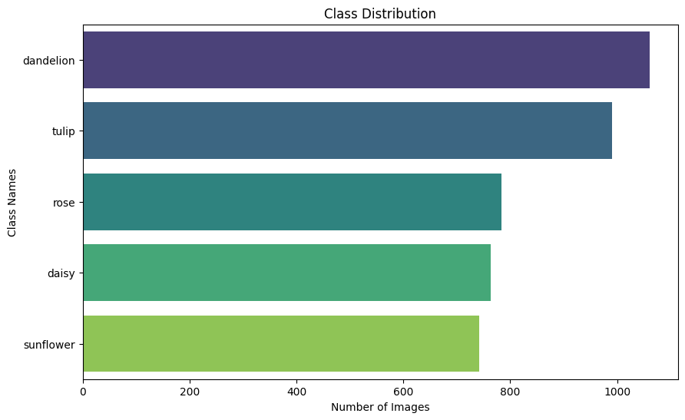
Class Distribution
Each of the classes has the following number of images distributed:

Slide 7
Thank You!!

